Slide 1
TRANSFORMS AND PARTIAL DIFFERENTIAL
UNIT II: FOURIER SERIES

Slide 2
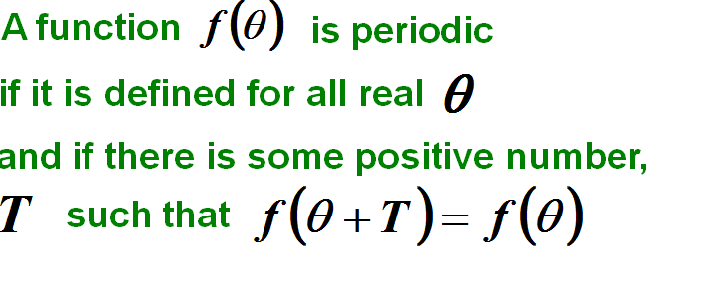
Periodic Functions

Slide 4
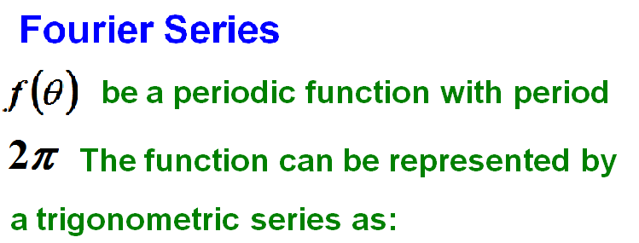

Slide 5
Definition of a Fourier series
A Fourier series may be defined as an expansion of a function in a series of sines and cosines such as
The coefficients are related to the periodic function f(x)
Henceforth we assume f satisfies the following (Dirichlet) conditions:
(1) f(x) is a periodic function;
(2) f(x) has only a finite number of finite discontinuities;
(3) f(x) has only a finite number of extrem values, maxima and minima in the
interval [0,2π].

Slide 8
A Fourier series is a convenient representation of a periodic function.
A Fourier series consists of a sum of sines and cosine terms.
Sines and cosines are the most fundamental periodic functions.

Slide 9
Fourier series

Slide 10
FOURIER COEFFICIENTS FOR (-π,π)

Slide 11
FOURIER COEFFICIENTS FOR (0,2π)

Slide 12
Fourier series

Slide 13
Change of interval from to
Change of interval from to
Change of interval from to
Change of interval from to
FOURIER COEFFICIENTS FOR

Slide 14
FOURIER COEFFICIENTS FOR

Slide 15
Interval | Parsevals Identity

Slide 16
Even and Odd Functions
Even Functions
The value of the function would be the same when we walk equal distances along the X-axis in opposite directions.
Mathematically speaking -

Slide 17
Odd Functions
The value of the function would change its sign but with the same magnitude when we walk equal distances along the X-axis in opposite directions.
Mathematically speaking -

Slide 18
Even functions can solely be represented by cosine waves because, cosine waves are even functions. A sum of even functions is another even function.

Slide 19
Odd functions can solely be represented by sine waves because, sine waves are odd functions. A sum of odd functions is another odd function.

Slide 20
The Fourier series of an even function
is expressed in terms of a cosine series.
The Fourier series of an odd function
is expressed in terms of a sine series.

Slide 21
1. Find the Fourier series expansion of f(x) = x², 0 < x < 2π. Hence deduce that

Slide 22
. Fourier series is

Slide 25
Put x = 0 in the above series we get
--------------- (1)

Slide 26
But x = 0 is the point of discontinuity. So we have
Hence equation (1) becomes

Slide 27
Now, put x = π (which is point of continuity) in the above series we get

Slide 28
Adding (2) and (3), we get

Slide 29
2. Expand in Fourier series of f(x) = x sinx for 0 < x < 2π and deduce the result
Sol. Fourier series is

Slide 32
Note:

Slide 34
When n = 1, we have

Slide 37
When n = 1, we have

Slide 39
Put x = in the above series we get

Slide 40
3. Find the Fourier series of
Hence evaluate the value of the series
Sol. Fourier series is

Slide 45
When we put x = 0, , π, 2π we will not get the given series.
So, using Parseval’s identity for Fourier series we have

Slide 47
4.Find the Fourier series expansion for the function
Solution:

Slide 51
Hence

Slide 53
4.Find the Fourier series expansion for the function
Solution:

Slide 55
=0

Slide 56
Hence

Slide 57
Solution:

Slide 58
Solution:

Slide 66
6.Find the Fourier series for
Solution:

Slide 72
7.Find the fourier series expansion for the function f(x) = 1 + x + x² in
(–π, π). Deduce
Sol. The given function is neither an even nor an odd function.

Slide 78
(i.e.)
Put x = π in the above series we get

Slide 79
But x = π is the point of discontinuity. So we have
Hence equation (1) becomes

Slide 80
. 8. Find the Fourier series expansion of (π – x)² in –π < x < π.
Sol. Fourier series is

Slide 83
9.Obtain the fourier series expansion for
Solution:

Slide 86
The required Fourier Series
Putting x=0 , we get,

Slide 95
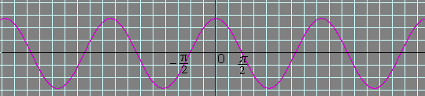

Slide 102
11.Expand f(x) = x – x² as a Fourier series in –l < x < l and using this series
find the root square mean value of f(x) in the interval.
Sol. Fourier series is

Slide 106
RMS value of f(x) in (–l, l ) is

Slide 107
12.Find the Fourier series expansion of
Hence deduce the value of
Sol. Let
then the given function becomes
Fourier series is

Slide 112
Using Parseval’s identity for Fourier series we have

Slide 114
. 13. Find the Fourier series expansion of
Hence deduce the value of the series
Sol. Fourier series is

Slide 117
Put
(which is point of continuity) in equation (1), we get

Slide 119
Put x = l in equation (1) we get
But x = l is the point of discontinuity. So we have
f(x) = l – x
f(l–) = l – l =0
f(x) = 0
f(l) = 0

Slide 120
14.Find the Fourier series for the function
Deduce that
Solution:
f(– x) = 1 – x in (–2, 0)
= f(x) in (0, 2)
and f(– x) = 1 + x in (0, 2)
= f(x) in (–2, 0)
Hence f(x) is an even function.

Slide 123
Put x = 0 in the above series we get

Slide 124
But x = 0 is the point of discontinuity. So we have
Hence equation (1) becomes

Slide 125
15.Find the Fourier series of periodicity 3 for f(x) = 2x – x² in 0 < x < 3.
Sol. Fourier series is

Slide 129
HALF RANGE FOURIER SERIES
FOR THE INTERVAL
COSINE SERIES
SINE SERIES

Slide 130
HALF RANGE FOURIER SERIES
FOR THE INTERVAL
COSINE SERIES
SINE SERIES

Slide 131
16. Find the half range sine series for f(x) = 2 in 0 < x < π.
Solution:
Half range sine series is

Slide 132
. 17. Expand f(x) = cos x, 0 < x < π in a Fourier sine series.
Sol. Fourier sine series is
2SinACosB = Sin(A+B) + Sin(A–B)

Slide 135
When n = 1, we have

Slide 136
18.Find the half range cosine series for the function f(x) = x (π – x) in 0 < x < π.
Deduce that
Sol. Half range fourier cosine series is

Slide 139
Parseval’s identity for half range fourier cosine series is

Slide 142
20.Find the half range sine series of f(x) = x cos x in (0, π).
Sol. Fourier sine series is

Slide 144
When n = 1, we have

Slide 146
21.Obtain the sine series for
Sol. Fourier sine series is

Slide 148
22.Find the half range cosine series for the function f(x) = x in 0 < x < l.
Hence deduce the value of the series
Sol. Half range Fourier cosine series is

Slide 151
Using Parseval’s identity for half range Fourier cosine series we have

Slide 153
23.Prove that
in the interval 0 < x < l
Sol. Since RHS contains sine series and given 0 < x < l, we have to find
half range Fourie sine series for f(x) = 1

Slide 155
24.Obtain the half range cosine series for f(x) = (x – 2)² in the interval 0 < x < 2.
Sol. Half range cosine series is

Slide 157
COMPLEX OR EXPONENTIAL FORM OF FOURIER SERIES

Slide 159
25.Find the complex form of the Fourier series of
in –1 < x < 1
Sol. The complex form of Fourier series of f(x) is given by
2l = 2
l = 1

Slide 162
26.Find the complex form of the Fourier series of
Solution:

Slide 165
HARMONIC ANALYSIS
The process of finding the Fourier series for a function given by numerical value is known as harmonic analysis. In harmonic analysis the Fourier coefficients a₀, a_{n} and b_{n} of the function
y = f(x) in (0, 2π) are given by
a₀ = 2 [mean value of y in (0, 2π)]
a_{n} = 2 [mean value of y cosnx in (0, 2π)]
b_{n} = 2 [mean value of y sinnx in (0, 2π)]

Slide 166
27. Find the Fourier series expansion up to third harmonic from the following data:
x : 0 1 2 3 4 5
f(x) : 9 18 24 28 26 20
Sol. Here the length of the interval is 6
(i.e.) 2l = 6
l = 3
Fourier series is

Slide 167
x | y | θ=πx/3 | ycosθ | ycos2θ | ycos3θ | ysinθ | ysin2θ | ysin3θ
0 | 9 | 0 | 9 | 9 | 9 | 0 | 0 | 0
1 | 18 | π/3 | 9 | –9 | –18 | 15.588 | 15.588 | 0
2 | 24 | 2π/3 | –12 | –12 | 24 | 20.784 | –20.784 | 0
3 | 28 | π | –28 | 28 | –28 | 0 | 0 | 0
4 | 26 | 4π/3 | –13 | –13 | 26 | –22.516 | 22.516 | 0
5 | 20 | 5π/3 | 10 | –10 | –20 | –17.32 | –17.32 | 0
Total | 125 |  | –25 | –7 | –7 | –3.464 | 0 | 0

Slide 168
Here n = 6

Slide 170
28.Find the Fourier series expansion up to second harmonic from the
following data:
Sol. Since the last value of y is a repetition of the first, only the first six values will be used.
Fourier series is

Slide 171
x | y | ycosx | ycos2x | ysinx | ysin2x
0 | 10 | 10 | 10 | 0 | 0
π/3 | 12 | 6 | –6 | 10.392 | 10.392
2π/3 | 15 | –7.5 | –7.5 | 12.99 | –12.99
π | 20 | –20 | 20 | 0 | 0
4π/3 | 17 | –8.5 | –8.5 | –14.722 | 14.722
5π/3 | 11 | 5.5 | –5.5 | –9.526 | –9.526
Total | 85 | –14.5 | 2.5 | –0.866 | 2.598

Slide 172
Here n = 6

Slide 174
29.Find the Fourier series expansion up to first harmonic from the following data:
Sol. Here the length of the interval is 12
(i.e.) 2l = 12
l = 6
Fourier series is

Slide 175
x | y | θ=πx/6 | cosθ | ycosθ | ysinθ
0 | 18 | 0 | 1 | 18 | 0
1 | 18.7 | π/6 | 0.866 | 16.1942 | 9.35
2 | 17.6 | 2π/6 | 0.5 | 8.8 | 15.2416
3 | 15 | 3π/6 | 0 | 0 | 15
4 | 11.6 | 4π/6 | –0.5 | –5.8 | 10.0456
5 | 8.3 | 5π/6 | –0.866 | –7.1878 | 4.15
6 | 6 | π | –1 | –6 | 0
7 | 5.3 | 7π/6 | –0.866 | –4.5898 | –2.65
8 | 6.4 | 8π/6 | –0.5 | –3.2 | –5.5424
9 | 9 | 9π/6 | 0 | 0 | –9
10 | 12.4 | 10π/6 | 0.5 | 6.2 | –10.7384
11 | 15.7 | 11π/6 | 0.866 | 13.5962 | –7.85
Total | 144 |  |  | 36.0128 | 18.0064

Slide 176
Here n = 12

Slide 177
PART-A
1. Write down the form of the Fourier series of an odd function in (– l, l) and the associated Euler’s formula for the Fourier coefficients.
Sol.

Slide 178
2. If f(x) = 3x – 4x³ defined in the interval (– 2, 2) then find the value
of a₁ in the Fourier series expansion.
Sol. Since f(x) is an odd function, a_{n} = 0.
Obtain the first term of the Fourier series for the function
f(x) = x², – π < x < π
Sol. f(x) = x² is an even function.
Fourier series is
Hence the first term of the Fourier series is

Slide 179
4.If f(x) = 2x in the interval (0, 4) then find the value of a₂ in the Fourier series
expansion.
Sol.

Slide 180
5. Define root mean square value of a function
Sol. The root mean square value of f(x) over the interval (a, b) is defined as
6.Find the root mean square value of f(x) = x² in (0, l)
Sol.

Slide 181
7.Find the root mean square value of a function f(x) in (0, 2π)
Sol. The root mean square value of f(x) over the interval (0, 2π) is defined as
8.Find the root mean square value of f(x) = 1 – x in 0 < x < 1
Sol.

Slide 182
9.Find the root mean square value of f(x) = π – x in 0 < x < 2π
Sol.

Slide 183
10.Write the sufficient conditions for a function f(x) to satisfy for the existence of a Fourier series.
Sol. i) f(x) is defined and single valued except possibly at a finite number of points in (–π, π)
ii) f(x) is periodic with period 2π
iii) f(x) and
are piecewise continuous in (–π, π)
Then the Fourier series of f(x) converges to f(x)
a) if x is a point of continuity
if x is a point of discontinuity.

Slide 184
11.Find the sum of the Fourier series for
at x = 1
Sol. Here x = 1 is a point of discontinuity
12.State the Parseval’s identity for Fourier series.
Sol. The Parseval’s identity for Fourier series in the interval (c, c + 2l) is
The Parseval’s identity for Fourier series in the interval (c, c + 2π) is

Slide 185
12.Write the formula for finding Fourier coefficients.
Sol.
13.Define RMS value of a function.
Sol. The RMS value of a function f(x) in (a,b) is defined by

Slide 186
14.State the Parseval’s identity for Fourier series.
Sol. The Parseval’s identity for Fourier series in the interval (c, c + 2l) is
The Parseval’s identity for Fourier series in the interval (c, c + 2π) is
15.Find the mean square value of the function f(x) = x in the interval (0, l).
Sol. Mean square value is

Slide 187
16.Find the value of a_{n} in the cosine series expansion of f(x) = 10 in the interval (0,10).
Sol.
. 17. What is the constant term a₀ and the coefficient a_{­n} in the Fourier series expansion of
f(x) = x – x³ in (–π,π).
Sol. Since the interval is (–π,π), let us verify whether the function is odd or even
f(– x) = (– x) – (–x)³
= – x + x³ = – (x – x³) = – f(x)
The given function is an odd function.
Hence a₀ = 0 and a_{n} = 0.

Slide 188
. 18. Find the constant term in the Fourier series corresponding to f(x) = cos² x expanded in the interval (–π,π).
Sol. Since the interval is (–π,π), let us verify whether the function is odd or even.
f(–x) = cos² (–x)= cos²x = f(x). Hence the function is even.
Hence the constant term in the Fourier expansion is

Slide 189
19. Find the constant term in the Fourier expansion of f(x) = x² – 2 in –2 < x < 2
Sol. f(–x) = (–x)² – 2 = x² – 2 = f(x), which is an even function
Hence the constant term in the Fourier expansion is

Slide 190
20. If the Fourier series of the function f(x) = x + x², in the interval (–π,π) is
--------------- (1)
, then find the value of the infinite series
Sol. Given
Put x = π in the above series we get
But x = π is the point of discontinuity. So we have

Slide 191
Hence equation (1) becomes

Slide 192
21. Does f(x) = tan x posses a Fourier series? Justify your answer.
Sol. For a function f(x) to have Fourier series expansion it must satisfy all the three criteria in Dirichlet’s conditions. But f(x) = tan x has value ∞ at
and so it is a discontinuous point and moreover it is an infinite discontinuity. So it does not have a Fourier series expansion.

